Slide 1

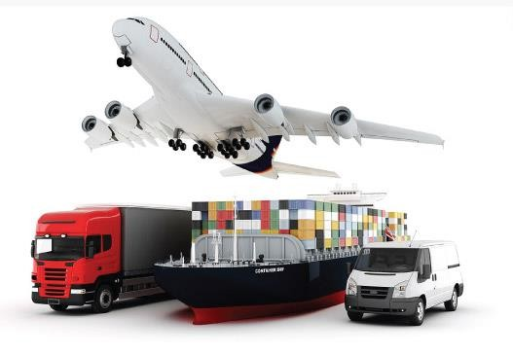
Behind every great leader company there was an even greater logistician….
Fast
Logistics
L.L.C
Freight Forwarding, Transportation, Custom Clearance, Logistics Services
www.fastlogistics.ae

Slide 2
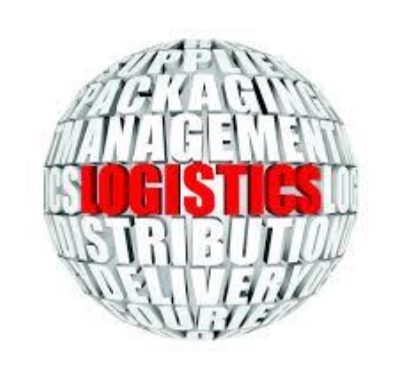
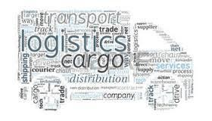
Welcome to
It gives us immense pleasure to introduce you to FL Family. FL , an International logistics vertical which enables unparalleled operational expertise & solution capability across the entire supply chain spectrum.
Head quartered in Dubai and spread across UAE with 5 branches, it is well resourced and competent organization operating and servicing a large customer base in various segments of the market. Since 2010 Fast logistics expand their business to obtain Egypt & KSA with 10,000 M2 WH and distribution channels & facilities.
We offer full fledge forwarding, shipping, warehousing packing and relating services. Our team works closely with our customer to understand their Business needs, goals and strategies and is committed to deliver exceptional services.
Team Fast Logistics!

Slide 3
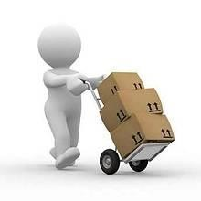
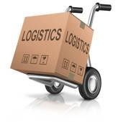
Fast logistics Facilities :
Local offices across UAE , Egypt and KSA.
Customer support facility 24/7 for all operations around the world.
100 + contracted trucks and mini Vans.
20,000 + M2 Average warehousing space in each country.
Custom clearance representative in each country.
Repacking facility support.
Service spaces for maintenance.
Freight forwarding (sea & air & Land)

Slide 4
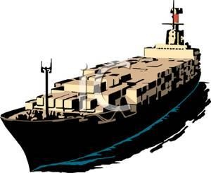
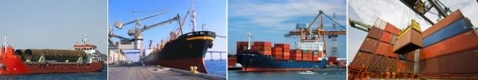
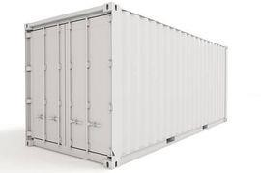
FREIGHT FORWARDING
Sea
Freight
Ocean Freight is one of the key elements in multimodal transportation service. In order to offer the best service possible, we have a dedicated Ocean freight department specializing in FCL/ LCL, Project cargo and different types of cargoes on a global scale.
The flexibility and range of Ocean Freight Services offered by Fast Logistics provides our customer economical alternatives to other, more costly modes of transportation. Our worldwide logistics services cover not only shipments from port-to-port, but also the complete door-to-door supply chain solution.
Over the years, Fast Logistics fostered strong business relationship with all major international and regional ocean carriers.

Slide 5
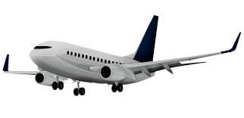
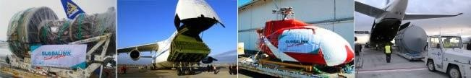
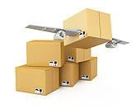
Air
Freight
Air Shipments are time sensitive so we are closely working with leading airlines to provide first class services to our clients .
We make sure to get your Cargo/Goods to its destination in the shortest period of time and in lowest possible rates. We provide complete information regarding the status of he consignments in transit.
We properly plan and execute whole procedures of moving the freight from one destination to another. To facilitate this movement, we are equipped with all the necessary amenities and tools. Apart from this, we have all the essential documents to ensure smooth and hassle free export custom clearance.

Slide 6


CUSTOM
CLEARANCE
Fast logistics has its own clearance license in Arabia and we are operating in all Saudi Egypt all the major ports. Having vast experience of more than 10 years in clearance, Fast Logistics enjoys a big account of satisfied clients across the Kingdom. Our clearance setup is backed by professional staff. We have dedicated trailers and trucks owned by Fast Logistics which allow us to deliver better services and flexibility in moving the shipment according to client’s convenience. We offer free offloading time up to 8 hours, we deliver the container along with carrier & get back empty container once unloading is done.

Slide 7
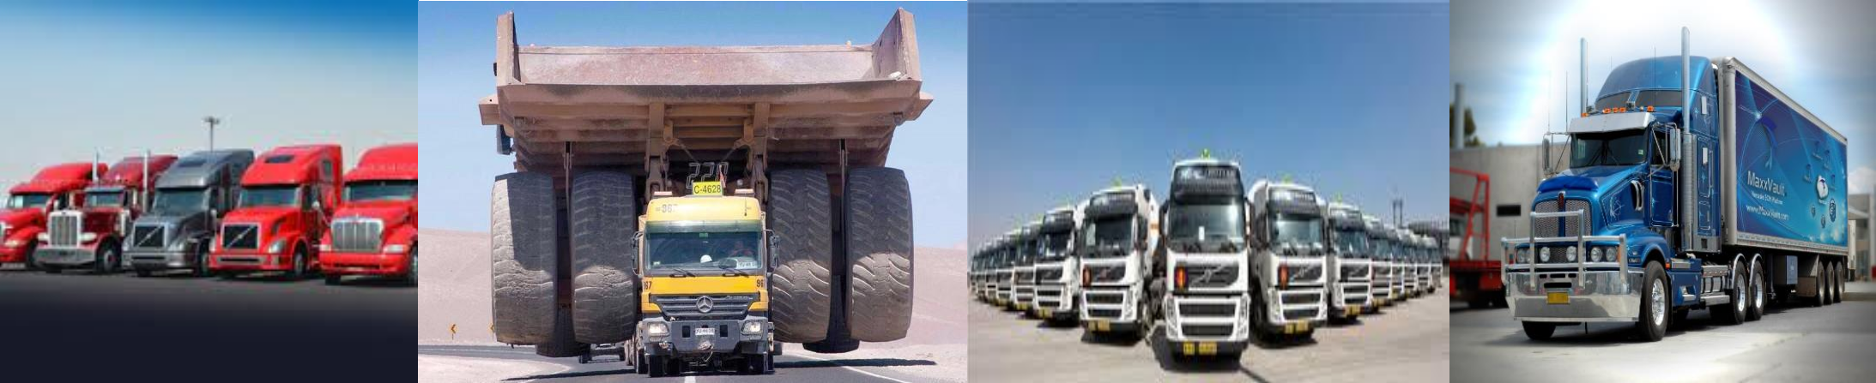
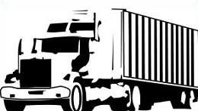
TRANSPORTATION
Fast logistics owns a fleet of 38 trailers and 8 trucks excluding our trailers fleet dedicated to customs
clearance Dept. We have highly professional and trained drivers. Our full fleet of trailers and trucks inventory enjoys third party insurance. Most of the trailers have 60 hours of shift time. In order to ensure the smooth operations we have mechanical works shop in Dubai.

Slide 8
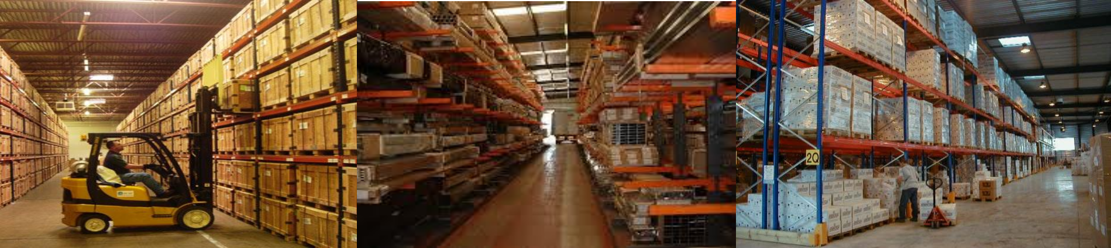
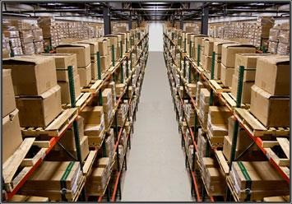
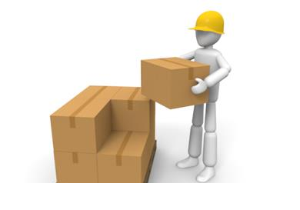
WAREHOUSING
&
LOGISTICS
Fast Logistics is equipped with modern warehousing facilities with space of 6000 Sq.meter.
We also acquired the space of 10,000 Sq. meter recently, our facility is equipped with state of art tools like CCTV Cameras, forklift, hand rails, crane, trucks and all necessary equipment required for a modern storage facility. We can handle and accommodate any size of shipment from personal effects to large industrial material, including packing, crating, Trucking Insurance and warehousing. Our warehouse
timing is from 0800 to 1700 hours, but for special cases or in urgency our staff will be available 24/7.
We manage end-to-end inventory planning and replenishment tailored to your requirements. Taking complete responsibility for your inventory, we find the efficiencies that eliminates unnecessary stock holding and subsequently decreases logistics cost.

Slide 9



